Slide 1



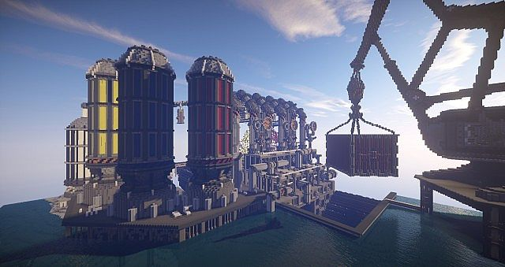








Automation of Software Engineering with OCI DevOps Build and Deployment Pipelines
APAC OCI Days – 24-26 May 2022
Lucas Jellema, CTO & Architect AMIS | Conclusion
Notes:
Automation of Software Engineering with OCI DevOps Build and Deployment Pipelines
Automation of software delivery has several advantages. Prevention of human error is certainly one. Consistent and complete execution of tried and tested build and deployment tasks as the only way to apply changes in the live environment. Once the pipelines have been set up, the engineers can focus on the software and applying the required changes to it. To bring that software all the way to production is a breeze. Oracle Cloud Infrastructure offers the DevOps service, introduced in the Summer of 2021. This service comes with git style code repositories, build servers and build pipelines, artifact repositories as well as deployment pipelines. This session introduces OCI DevOps and demonstrates how software can be built and deployed on OKE Kubernetes, Compute Instance VMs and Oracle Functions. From simple source code an application is put in production without manual intervention in the build and deployment process.

Slide 2

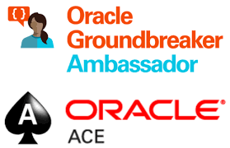



Lucas Jellema CTO for AMIS | Conclusion Cloud Solution Architect
lucas.jellema@amis.nl | technology.amis.nl | @lucasjellema | lucas-jellema

Slide 3





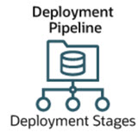
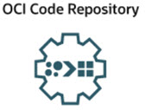
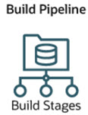
Discussion Topics
Deployment
Build
Source Code
Artifact

Slide 4
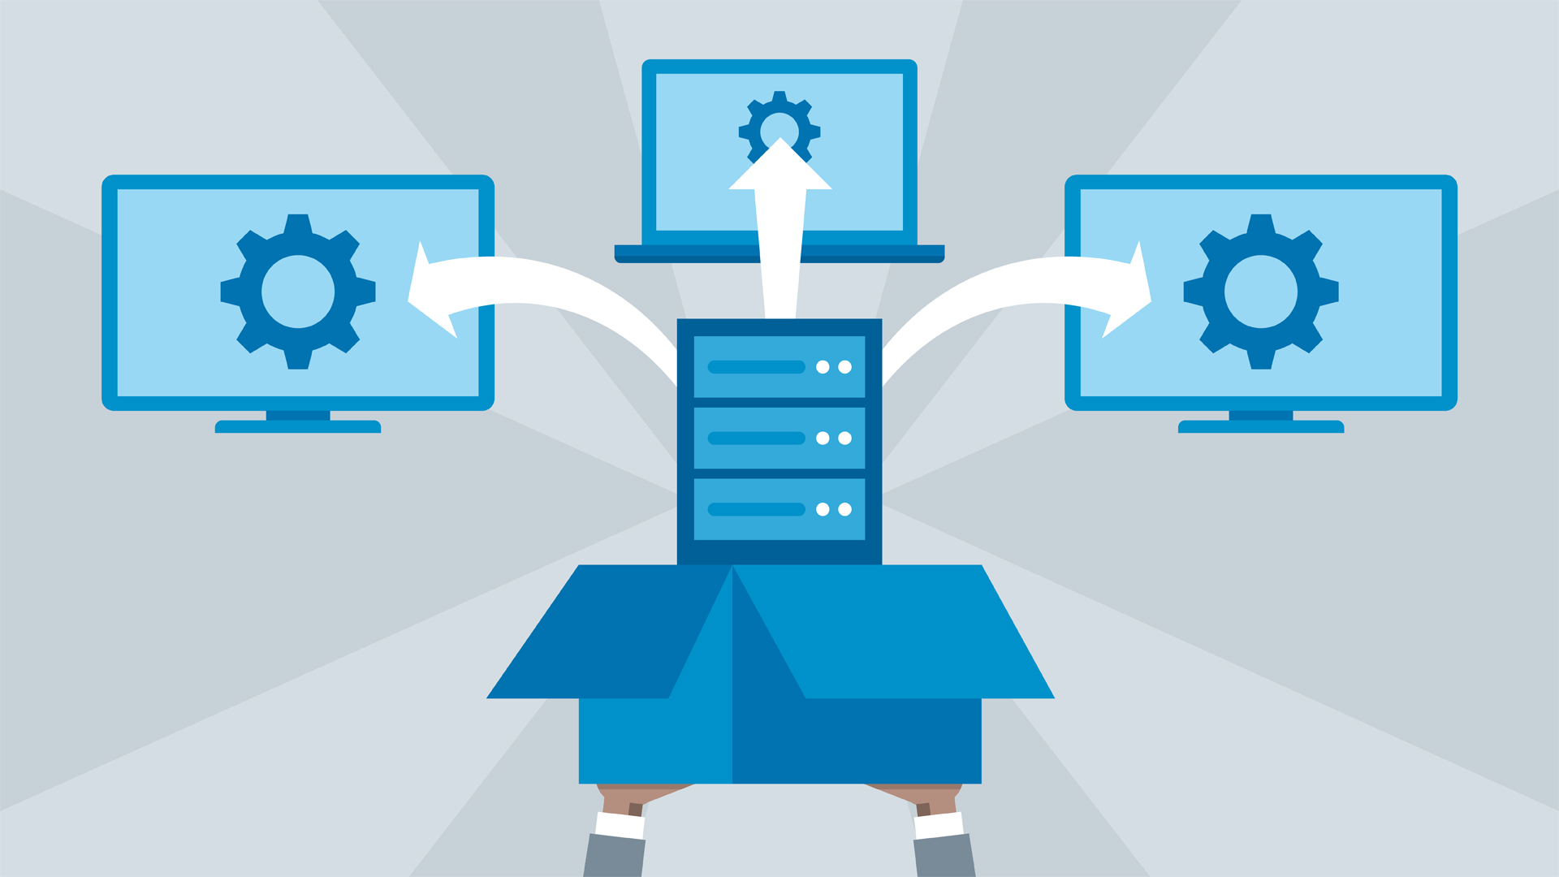
Deployment
Objective: a running software product
in the designated target environment
Requirements
proven
no human involvement
secure
triggerable
tailored to environment
audit

Slide 5
OCI DevOps Deployment Pipelines
Automated Deployment to OCI services
Application to Compute Instance (VM)
Container Image and Kubernetes artifacts to OKE
Function Container Image to OCI Functions

Slide 6


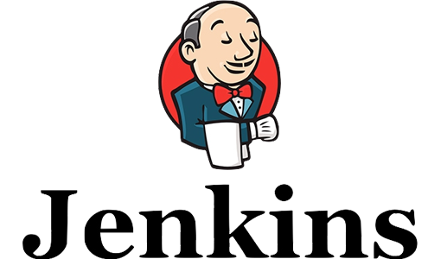
OCI DevOps Deployment Pipelines
run as Resource Principal inside OCI
require permissions on target environments (through policies and dynamic group)
retrieve artifacts from container image registry and generic artifact registry
are simple to trigger
only requires permission on pipeline
can include OCI Function calls
for environment preparation, smoke test, ..
can include manual approval steps
can be triggered from Jenkins pipeline
support Blue/Green & Canary deployment strategies (for VM and OKE)
“OCI native” – logging, events, audit, CLI/Console
are free

Slide 7
OCI Deployment Pipeline for Compute Instance
Artifacts are retrieved from Artifact repository and copied to the VM
Deployment Configuration contains Shell commands that are executed on the target VM
at present: Oracle Linux, CentOS, AmalLinux OS
Parameters can be defined on the pipeline
parameter references can be used in the deployment configuration to set environment variables
IAM Policy is required – grant permission to dynamic group “to manage instance-agent-command-family”
Deployment pipeline needs to be included in the group
Agent
Dynamic Group

Slide 8
OCI Deployment Demo
Existing Web application - packaged as zip-file my-server.zip artifact
binary executable (compiled from Go app) and static web resources
Existing Deployment Pipeline
my-server.zip: Download, Update an Upload (as new version of artifact)
Create new Compute Instance – Oracle Linux VM
Target Deployment Pipeline to new VM
Run Deployment Pipeline – set parameter to refer to new version of artifact
generic artifact registry
Environment

Slide 9
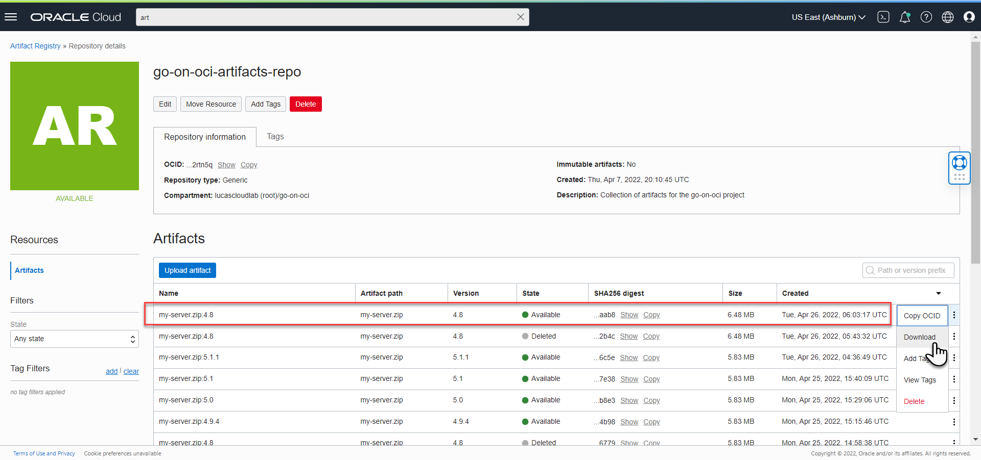
Download my-server.zip from Artifact Registry

Slide 10
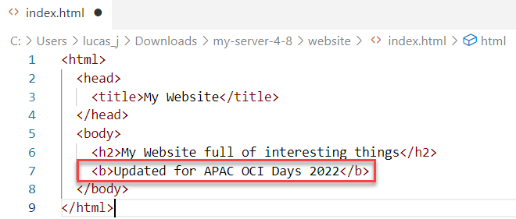
Update web application – create new artifact

Slide 11
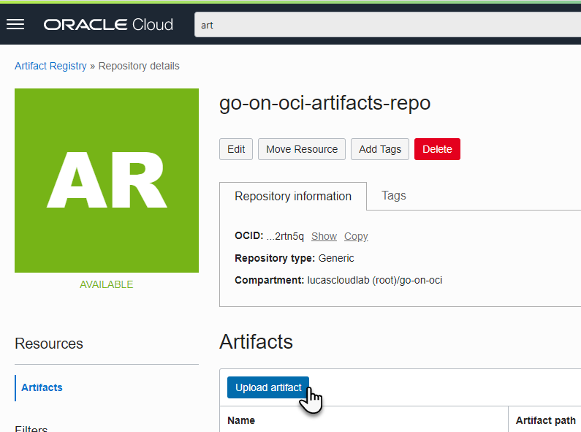
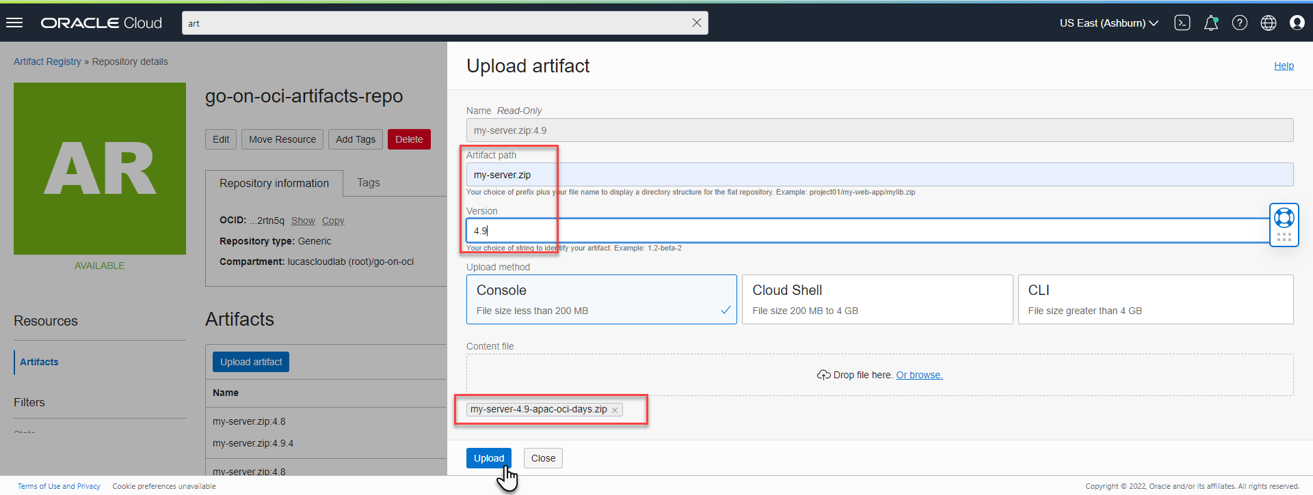
Upload new Artifact to Artifact Registry

Slide 12
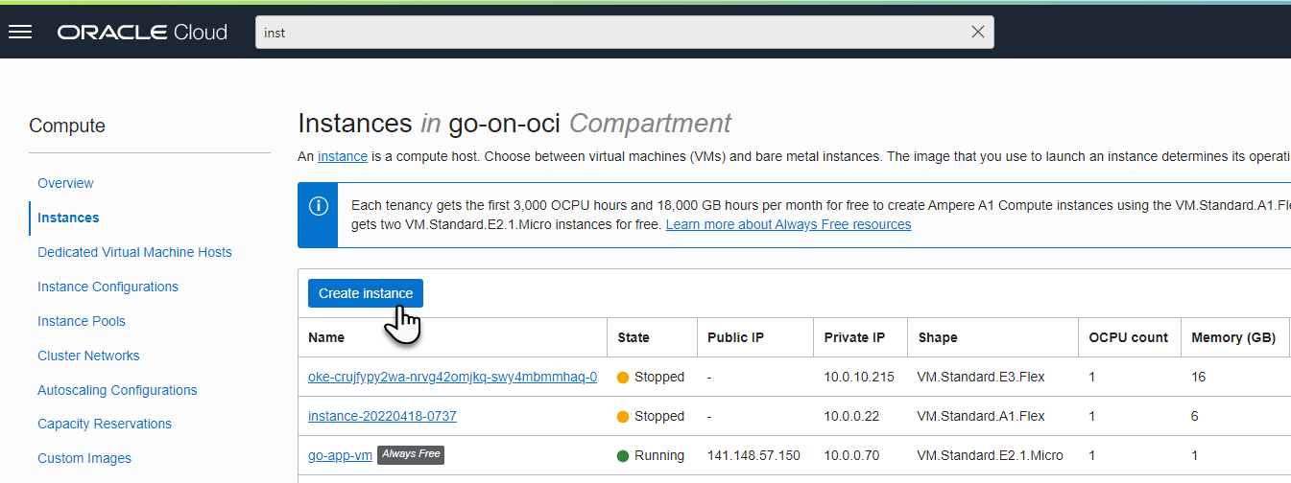
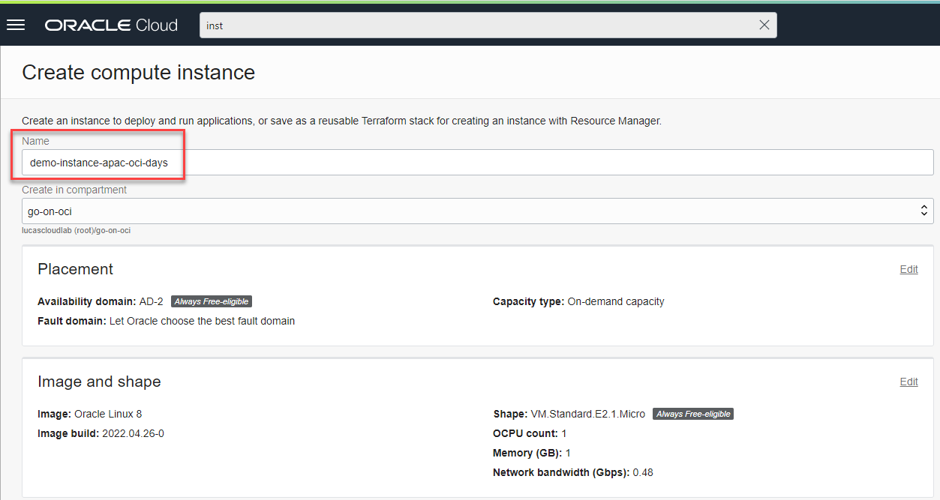
Create Compute Instance – Oracle Linux VM

Slide 13
Create Compute Instance – Oracle Linux VM

Slide 14
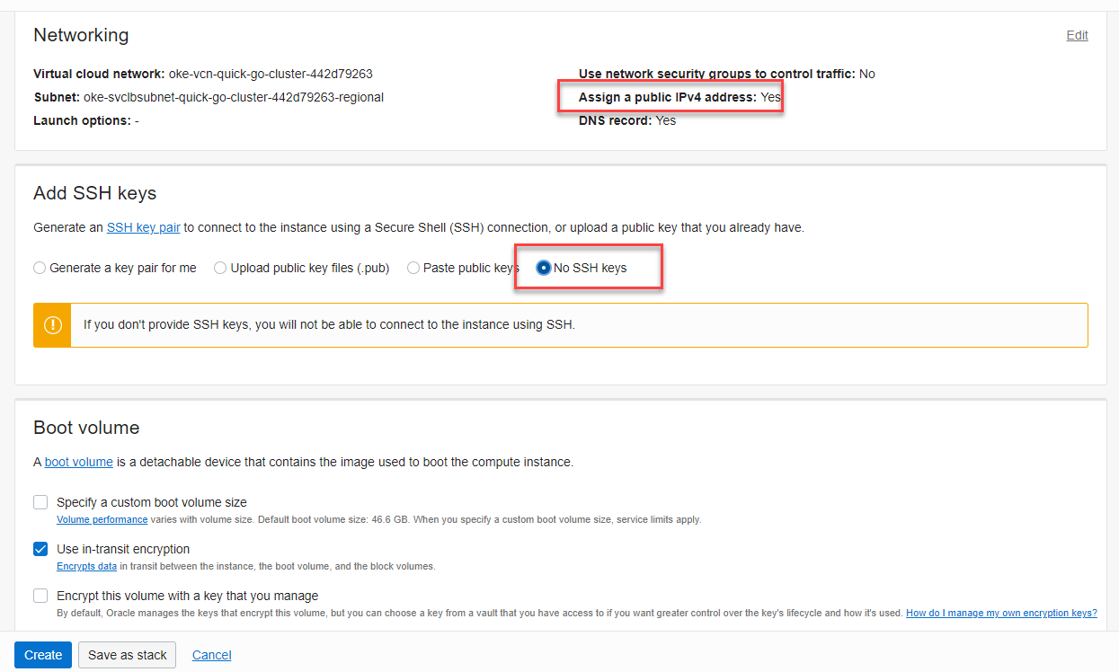
Create Compute Instance – Oracle Linux VM

Slide 15
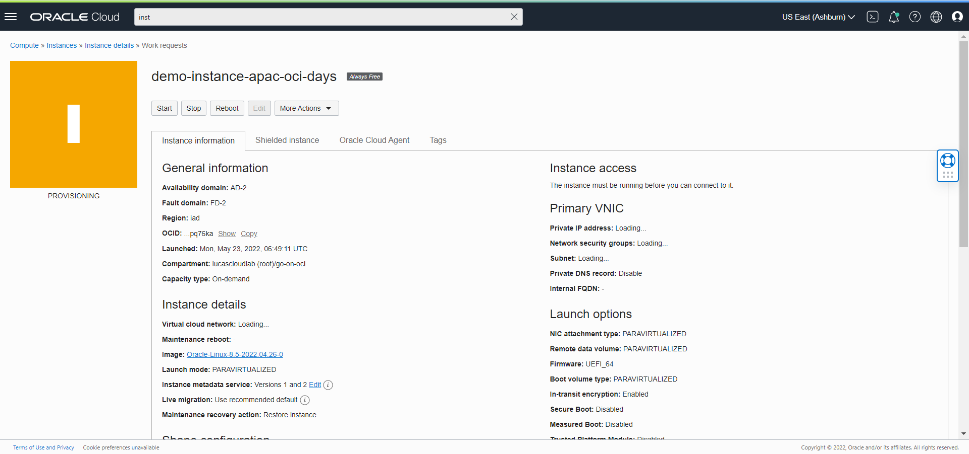
Provisioning Compute Instance

Slide 16
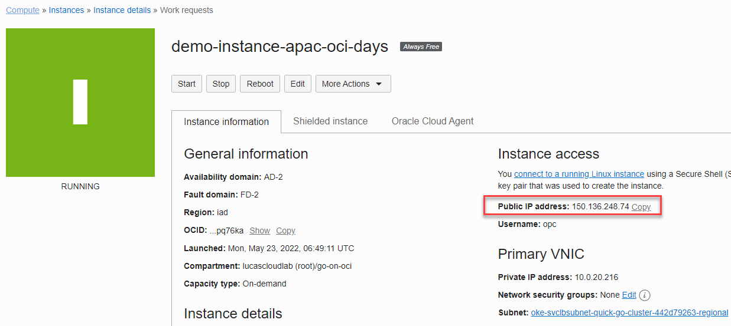
Provisioning Compute Instance

Slide 17
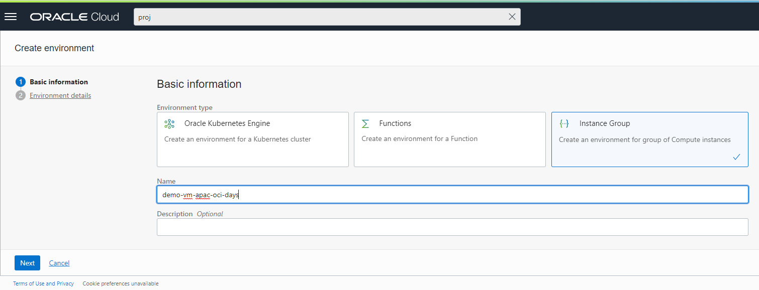
Define DevOps Environment for new Compute Instance

Slide 18
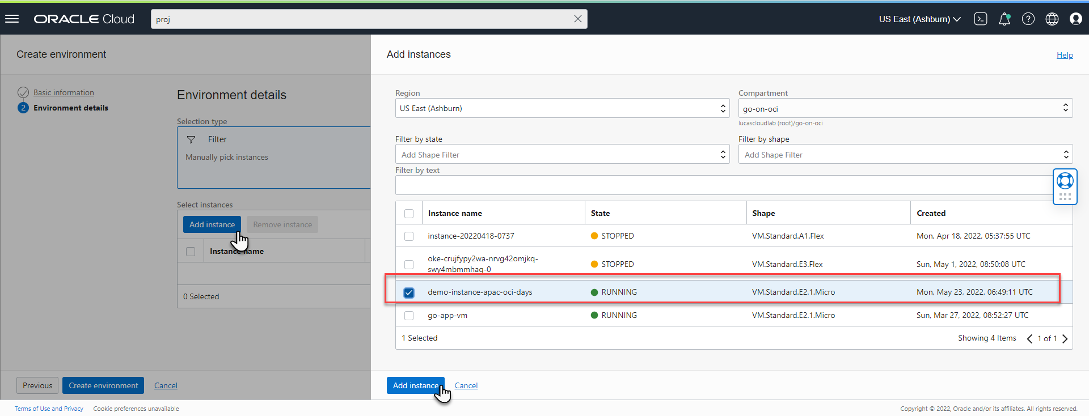
Define DevOps Environment for new Compute Instance

Slide 19
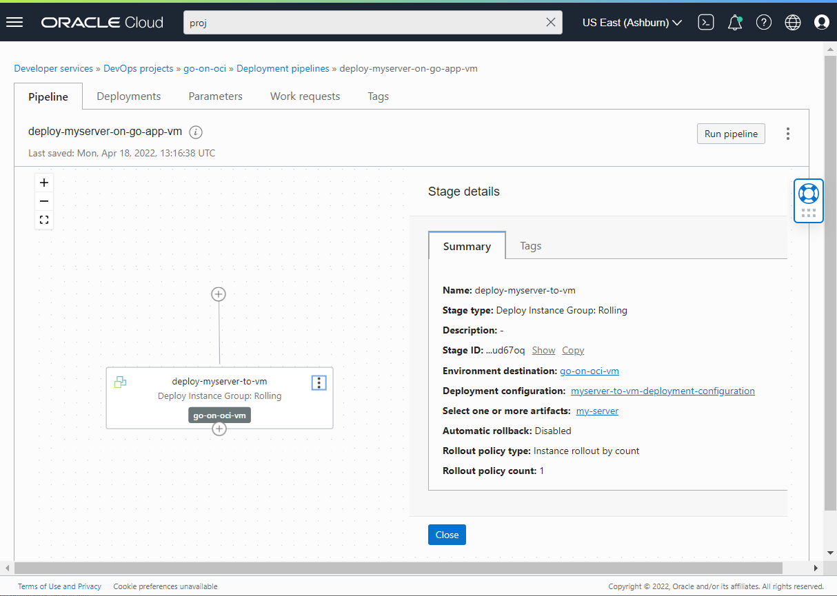
Update Deployment Pipeline
Target the right Environment
Deploy the right [version of the] my-server.zip Artifact

Slide 20
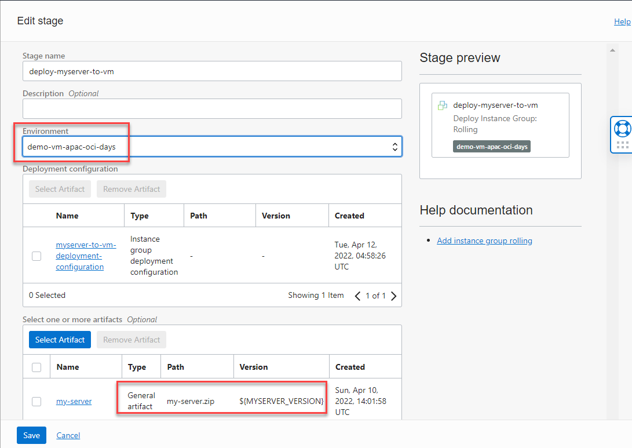
Update Deployment Pipeline

Slide 21
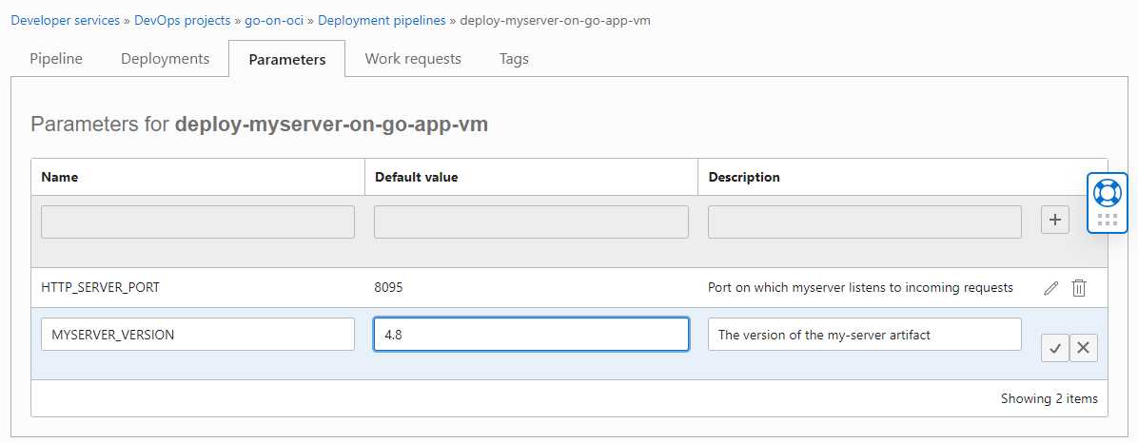
Update Deployment Pipeline - Parameter

Slide 22
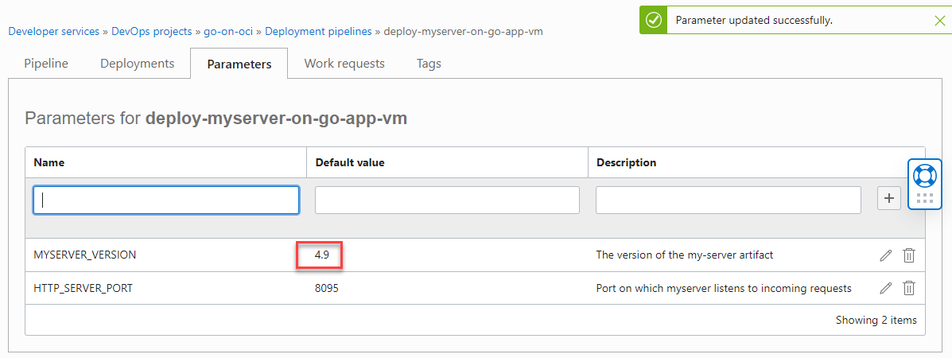
Update Deployment Pipeline - Parameter

Slide 23
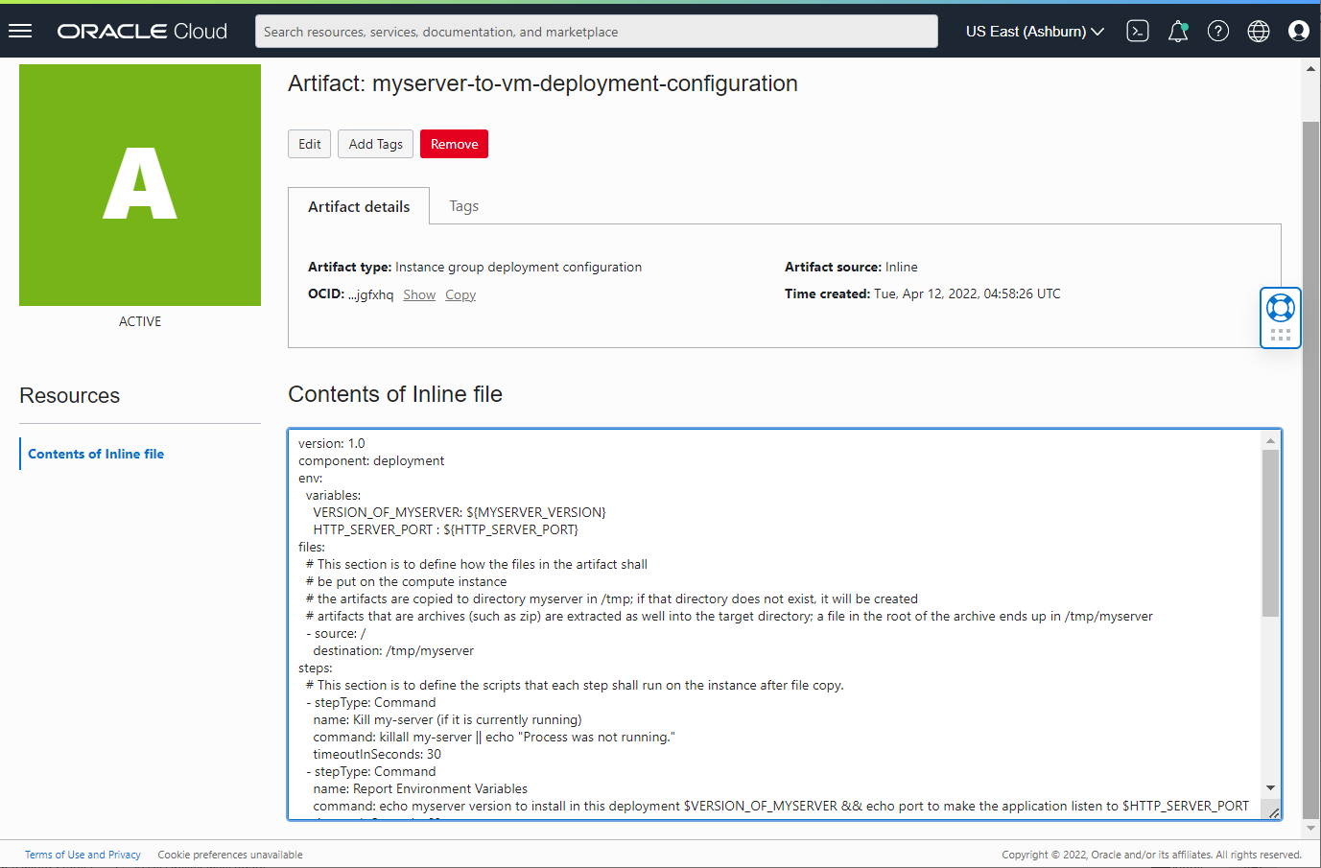
Deployment Specification

Slide 24
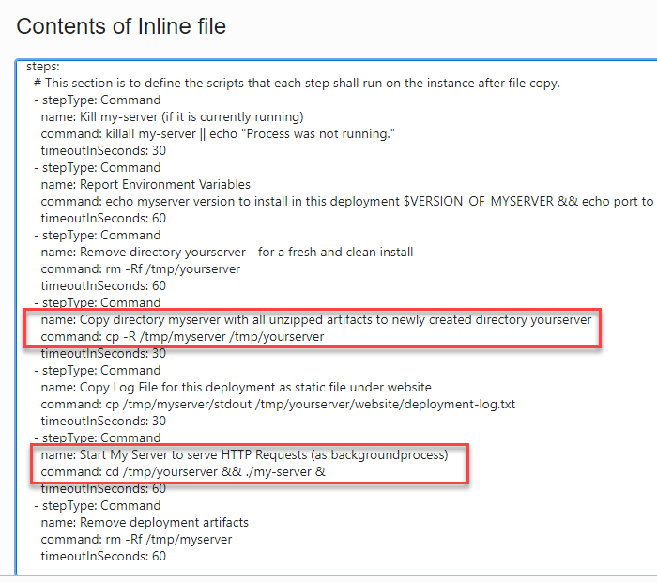
Deployment Specification

Slide 25
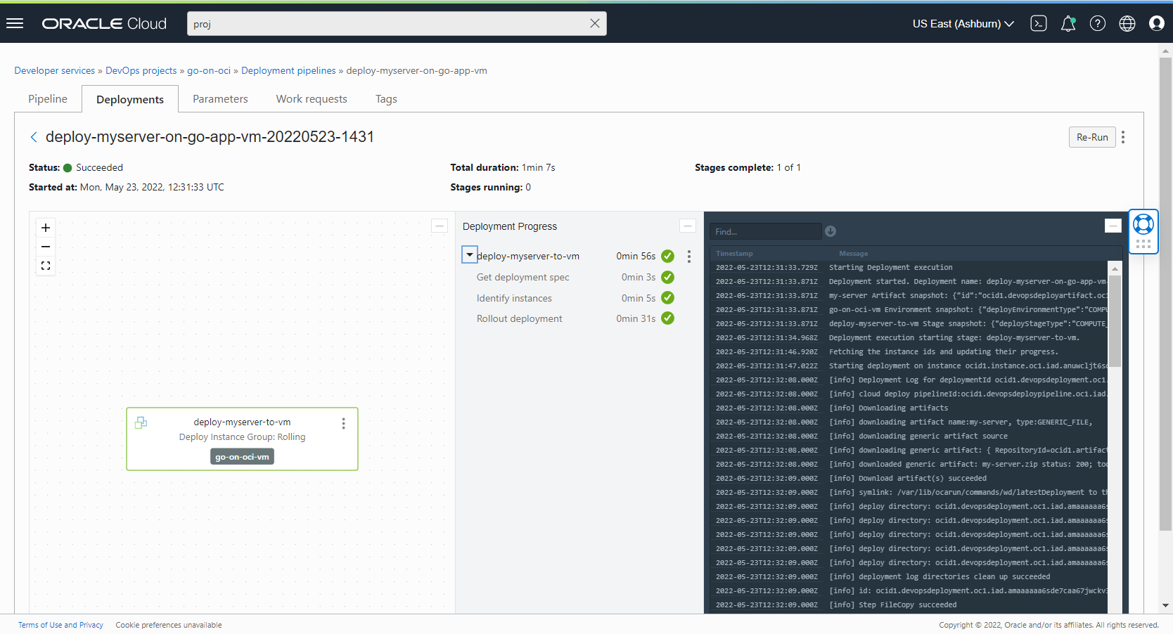
Run Deployment Pipeline

Slide 26
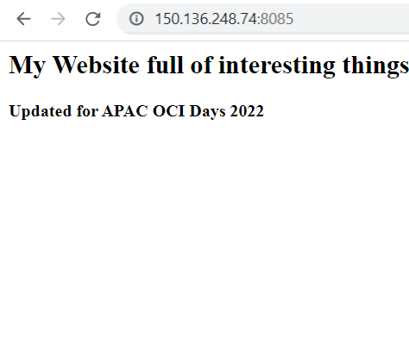
When Deployment is Complete …

Slide 27
Requirements (not shown in demo)
Compute Instance Run Command and Management Agent plugins enabled on Compute Instance Cloud Agent
Deployment Pipeline has IAM permissions for operations on VM
Dynamic Group includes pipeline, Policy grant permissions to group
subnet allows incoming network traffic from public internet to port 8095
Network Security List Ingress Rule is defined
configure firewall on VM – open up port 8085

Slide 28
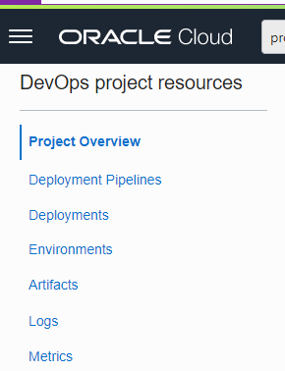
OCI DevOps Projects
generic artifact registry
container image registry
DevOps Project
Environment

Slide 29
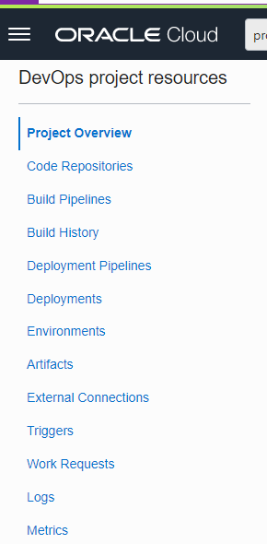


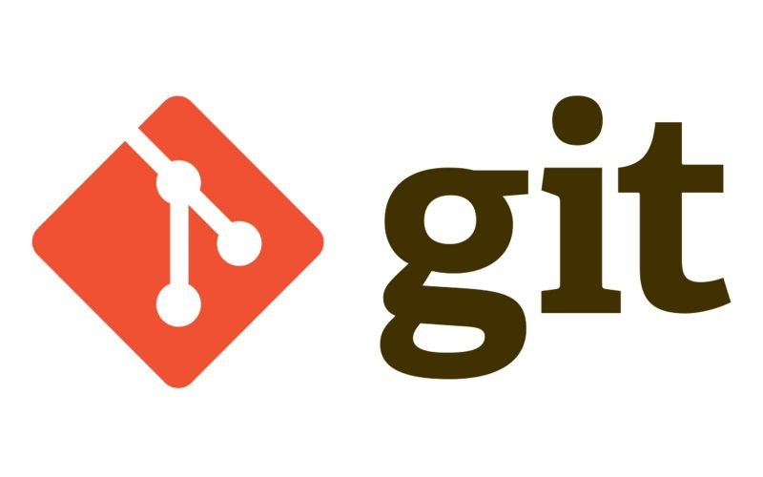
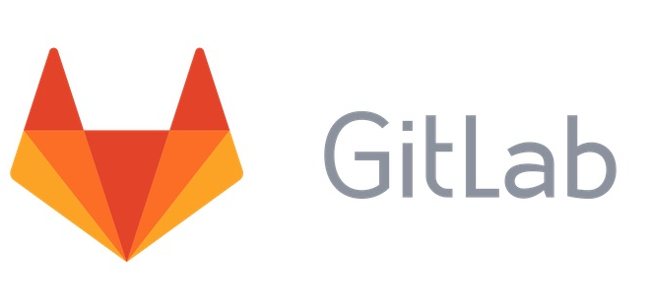

OCI DevOps Projects
generic artifact registry
container image registry
DevOps Project
Environment
build server
VM

Slide 30
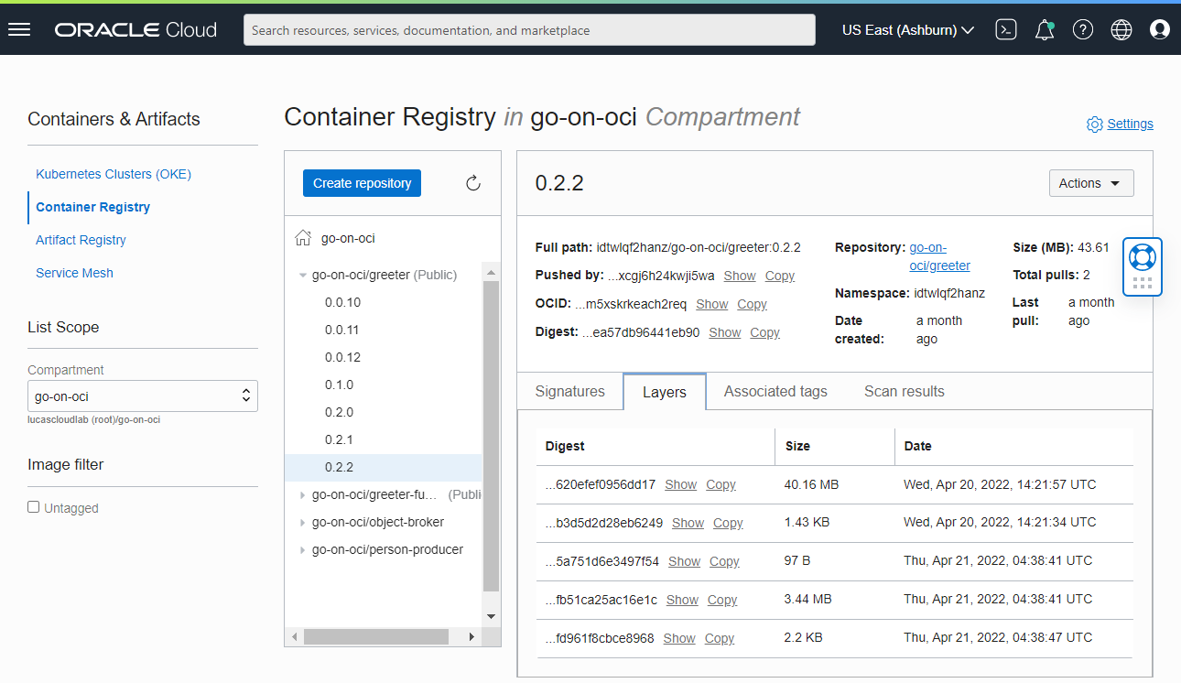
OCI DevOps Container Image Registry
Container [Image] Registry
Store for tagged Container Images
Docker Registry compliant
Public and private container images
Can be published to by Build Pipeline
Read from by Deployment Pipeline

Slide 31
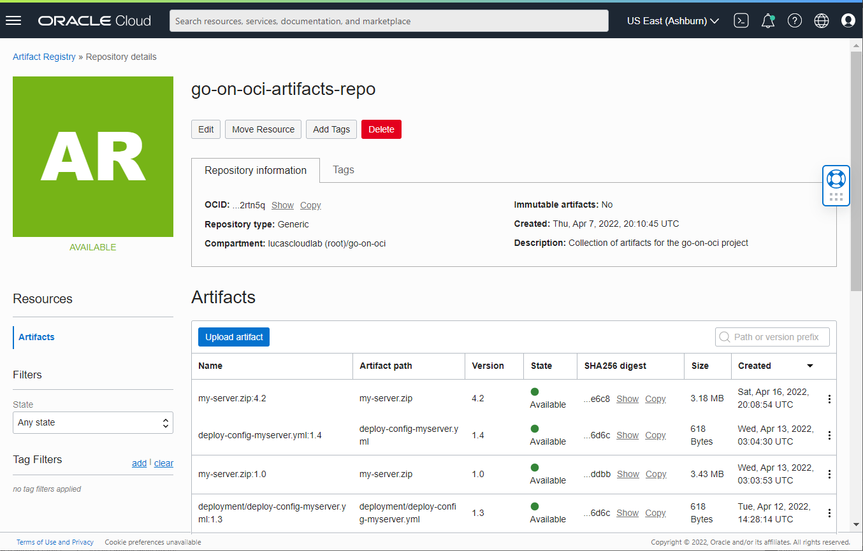
OCI DevOps [Generic] Artifact Registry
Registry for any type of file
Organized in Repositories
Files can be uploaded and downloaded through OCI Console
Can be published to by Build Pipeline
Read from by Deployment Pipeline

Slide 32
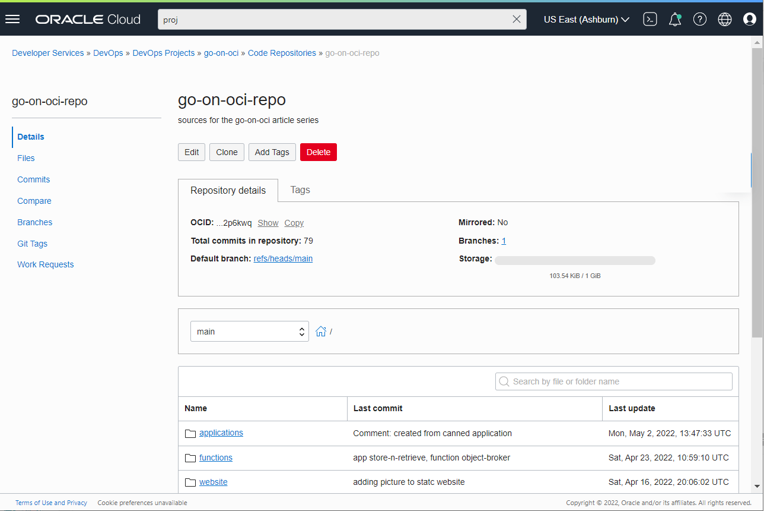
OCI DevOps Code Repository
git style
accessible from any git client
can be a mirror from external repository
synched from GitHub, GitLab, BitBucket
only storage costs are charged
simple read only UI in OCI Console

Slide 33
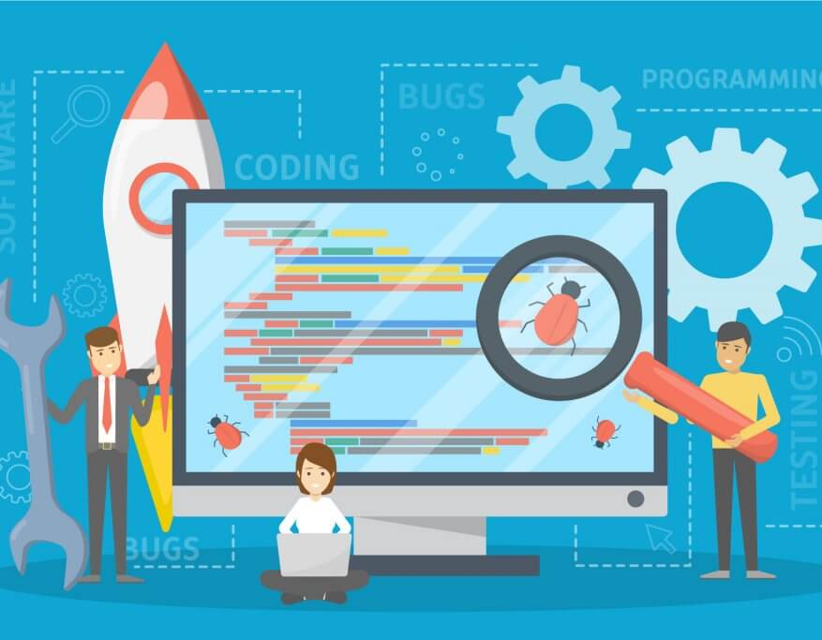
Build
Objective: Produce deployable artifacts
after running linting, code QA, tests
Requirements
automated, repeatable, proven
triggerable from source code events
easy for software developer
integrated in OCI
source code, artifact & container registries, trigger deployment
logging, events, audit, IAM
cheap and plenty build server

Slide 34
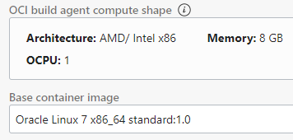
Build Server
Currently only one VM image
Oracle Linux 7, 1 OCPU, 8 GB RAM
Pre-installed tools and language environments
Bash, Maven, Gradle, Helm, git
Docker, Fn CLI, OCI CLI
Java, Python, Ruby, Node, Go, PHP
Build server has access to internet for download and installing additional tools, container images, git repositories
Planned: custom build server images
Note: build server compute costs are charged - for the time the server is active
DevOps Project
build server
VM
Notes:
https://docs.oracle.com/en-us/iaas/Content/devops/using/runtime_details.htm

Slide 35
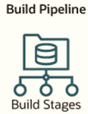
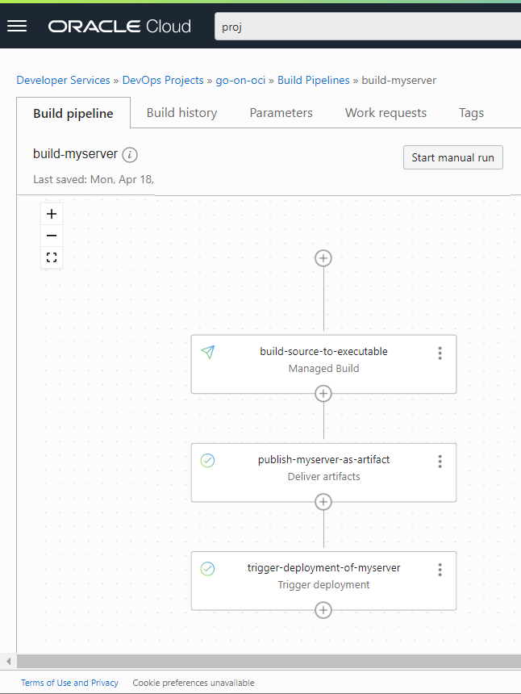
Build Pipeline
Multiple stages – sequential or parallel
Four types of stage:
Managed Build – run script on build server
Deliver Artifact – publish files / container images
Trigger Deployment Pipeline
Wait
Triggered by
Event in source code repository
Humanual action
API call
Parameters can be associated with build pipeline
optionally set for each run to override default values
used in build specification script and in artifact reference
passed to triggered deployment pipeline

Slide 36
Managed Build Stage
Retrieve sources from one or more repositories to the build server
Execute steps in build specification yaml file
part of source code repository
contains Linux Shell commands
Designated files produced by stage are available as output
to be published to artifact registry
DevOps Project
output (zip-file, json-document, container image)
build specification yaml file
build server
VM

Slide 37
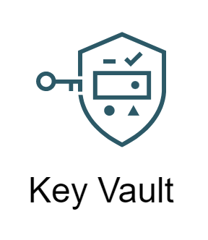
Managed Build Stage (2)
Build Pipeline parameters are available when build server runs
values from Vault Secrets can be pulled in at build run time
Note: build server runs under resource principal authentication
inheriting IAM permissions from Dynamic Group
example: invoke function, run OCI CLI or Terraform with OCI provider
DevOps Project
Dynamic Group
output (zip-file, json-document, container image)
para
meters
build specification yaml file
build server
VM
para
meters

Slide 38
Demo
Source code for my-server.go app in Code Repository is starting point
including build-specification.yaml
Build pipeline
parameter for artifact version
1. managed build stage – associated with code repository [path]
compile, lint, code QA, test, build to executable, package to zip archive
2. publish artifact stage – upload zip-file to artifact registry
3. trigger deployment pipeline stage – start deployment to Compute Instance
generic artifact registry
DevOps Project
2
parameter
parameter
3
1
build server
VM

Slide 39
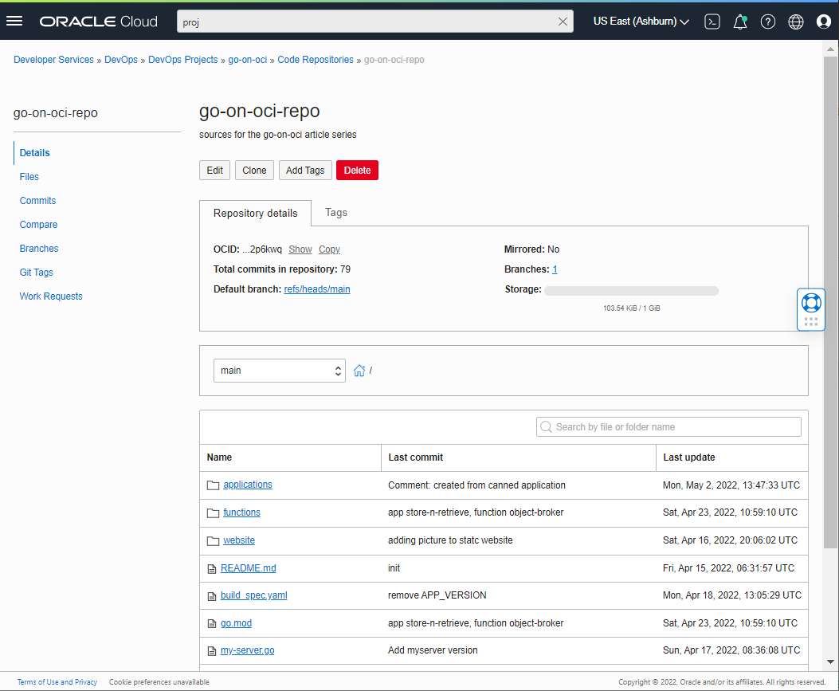
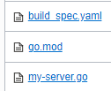
Source Code Repository

Slide 40
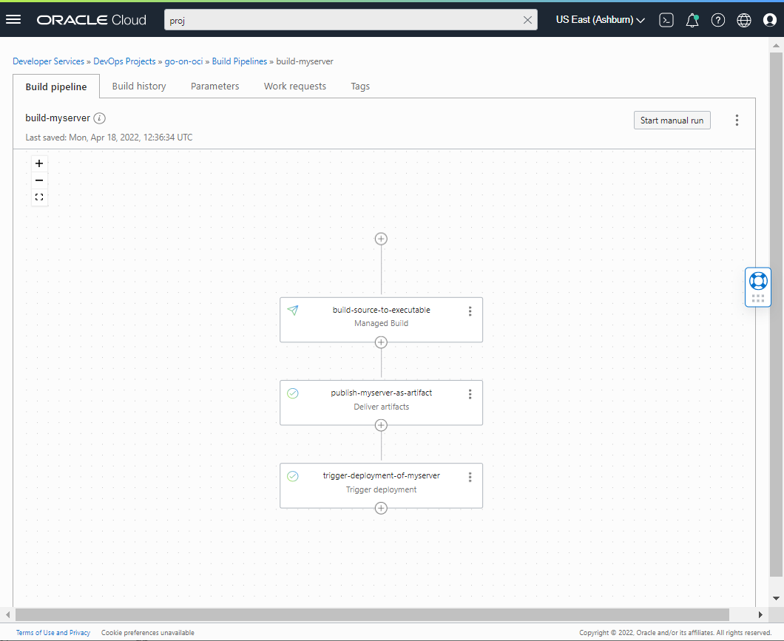
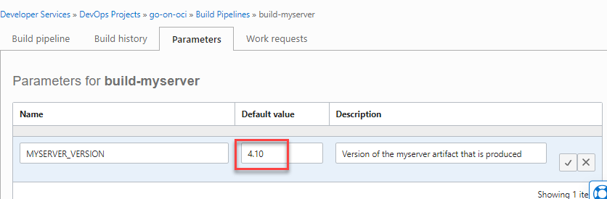
Build Pipeline

Slide 41
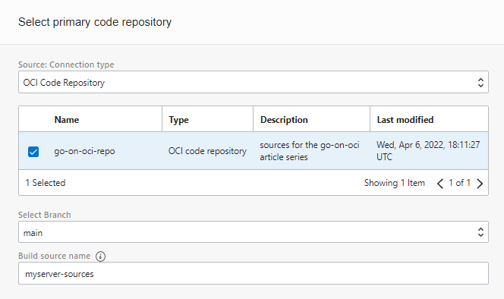
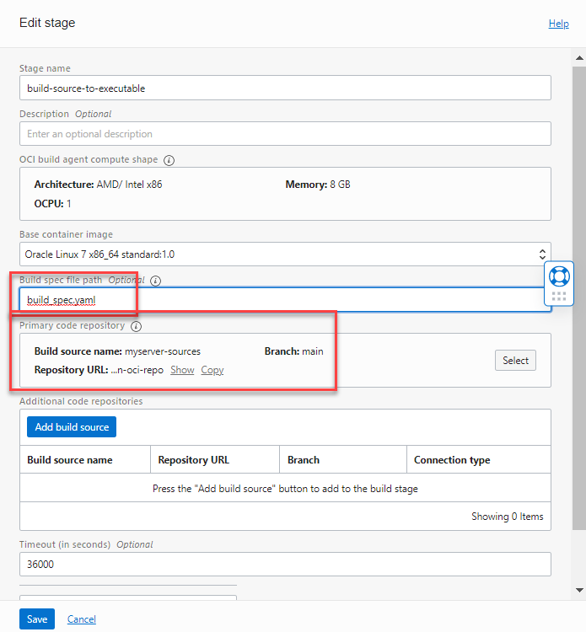
Managed Build Stage

Slide 42
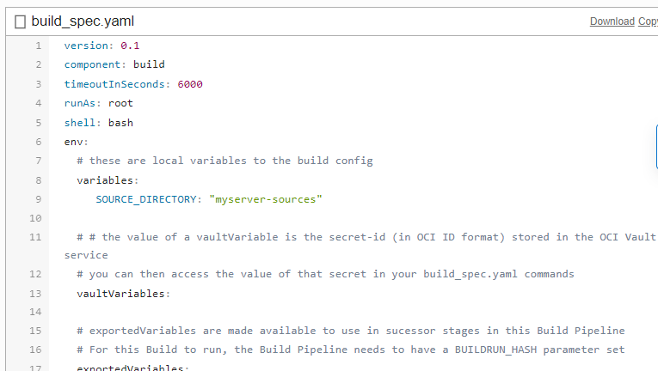
Build Specification (1)

Slide 43
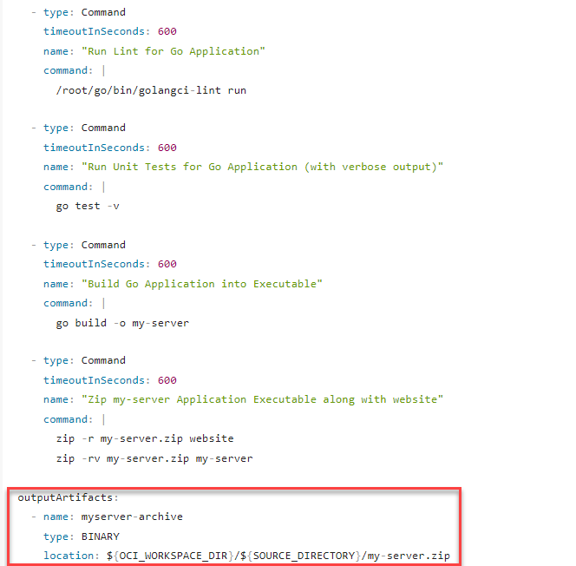
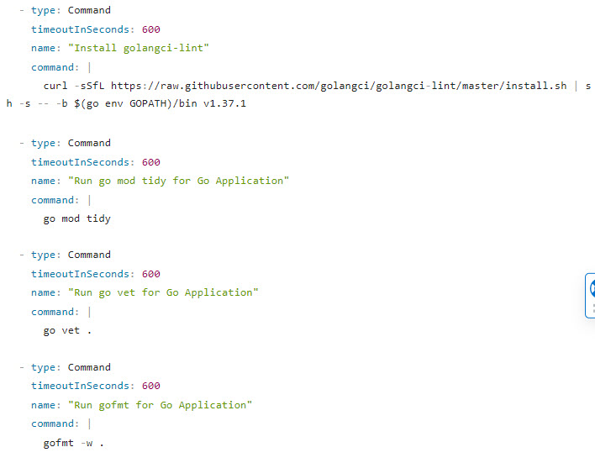
Build Specification (2)
Lint source code
Install golangci-lint on build server
Run Unit Tests
Run go mod tidy
Build Executable
Run go vet
Create Archive
Format Go source code
Define output from build stage

Slide 44
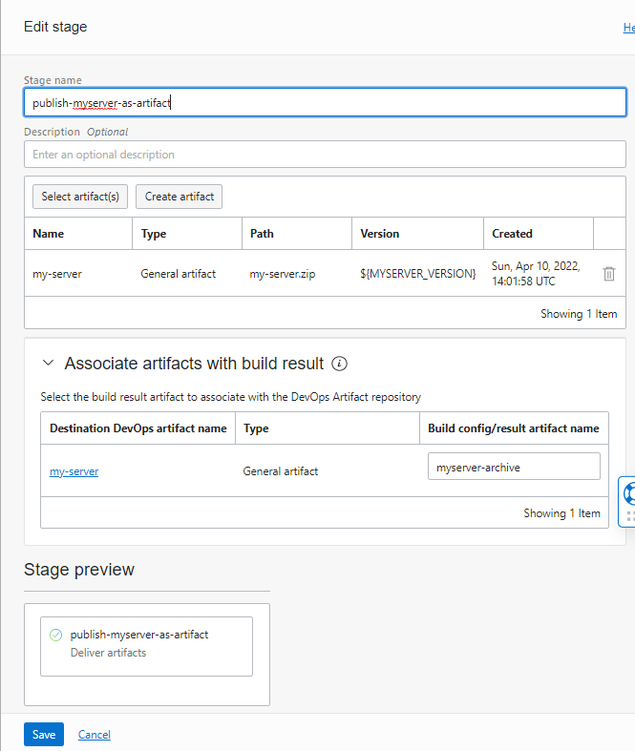
Publish Artifact Stage
parameter

Slide 45
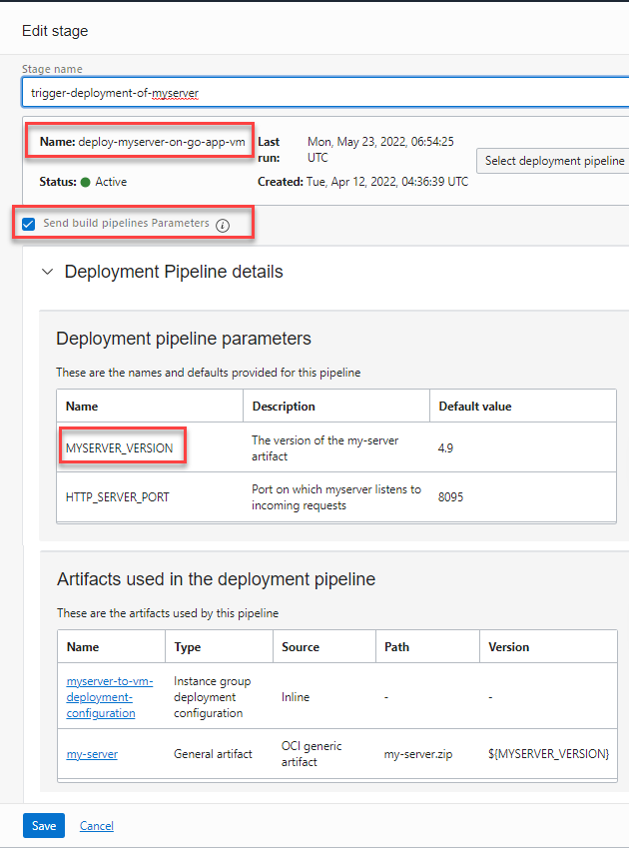
Publish Artifact Stage
parameter
parameter

Slide 46
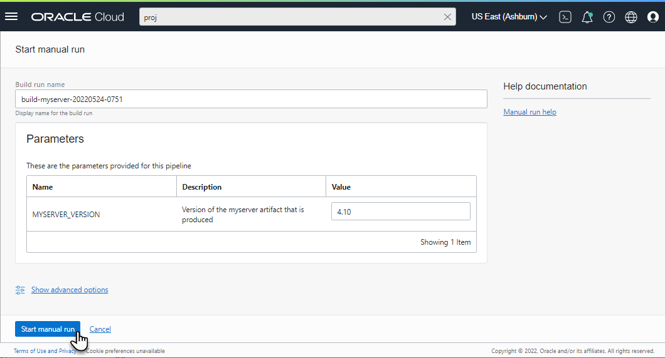
Run Build Pipeline
my-server.zip:4.10
generic artifact registry
DevOps Project
build server
VM
APAC OCI Days 2022 - Automation of Software Engineering with OCI DevOps
46

Slide 47

Run Build Pipeline

Slide 48

Run Build Pipeline

Slide 49

Run Build Pipeline – Publish Artifact (with version derived from parameter)
my-server.zip:4.10
generic artifact registry

Slide 50


Run Build Pipeline – Trigger Deployment Pipeline (pass build line parameters)
parameter
parameter

Slide 51

Managed Build Stage
Can invoke OCI ADM (Application Dependency Management) – to analyze vulnerabilities in application (GA May 2022)
Can build container images – that “publish artifact” pulls from local container image registry on build server
Infrastructure as Code – on OCI resources
Can run OCI CLI commands
Can [install Terraform and] apply Terraform plans OCI provider
Can run any Linux shell job
Multiple manage build stages can be included in one build pipeline
build-specification files for generic actions can be reused across pipelines
for example: build-spec for exposing a service through OCI API Gateway

Slide 52
Finale
Automation is important
proven, repeatable, triggered, secure, fast/at any time, fewer skills required
OCI DevOps provides automation
of software build
of software deployment to OCI runtime platforms
Embedded in OCI
IAM, logging, events, code repository and artifact registry
console, CLI, REST API, Terraform
Young service – quickly growing
Free or Cheap
DevOps Project
Environment
build server
VM

Slide 53
Thank you for your attention I hope this was useful
lucas.jellema@amis.nl | technology.amis.nl | @lucasjellema | lucas-jellema

Slide 54


